Slide 1
cmpo running notes
Shuang Liang @ IOP-CAS

Slide 2
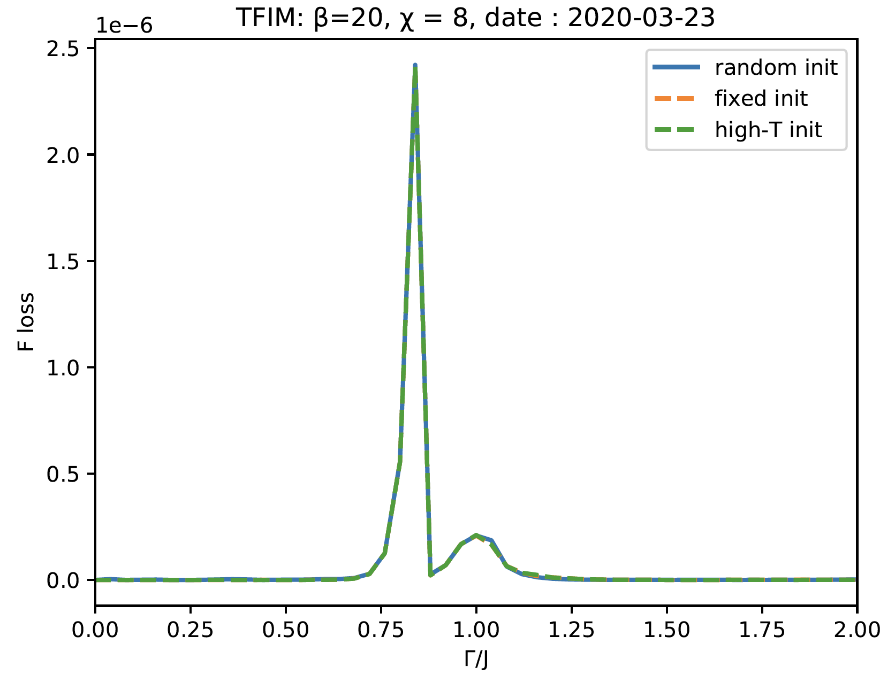
β=20, Free energy loss
Notes:
high-T init： init beta = 20 cmps by beta = 1cmps

Slide 3
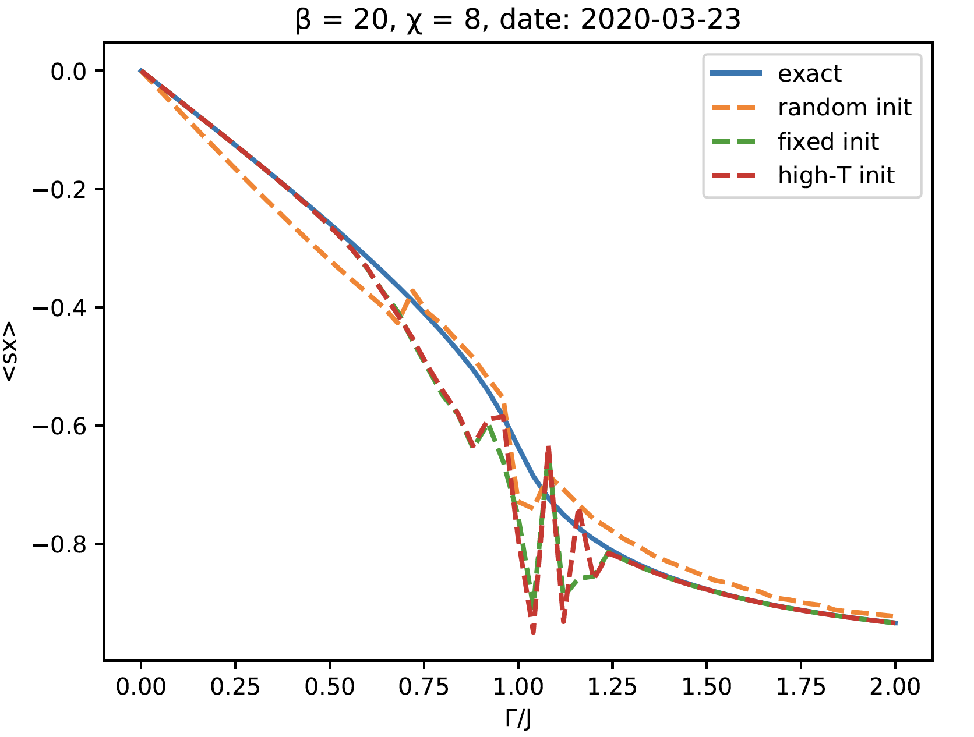
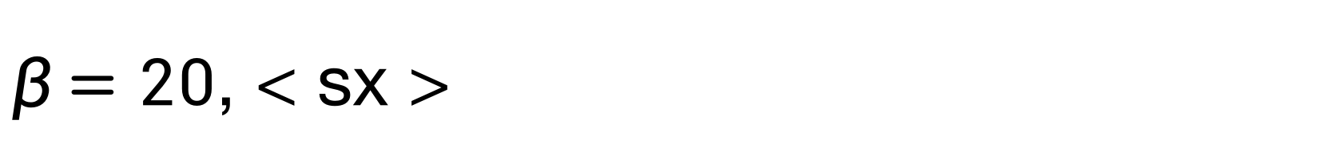
$β=20$, < sx >
错误原因： 低、高能谱权重颠倒
设计Test
Notes:
high-T init： init beta = 20 cmps by beta = 1cmps

Slide 4
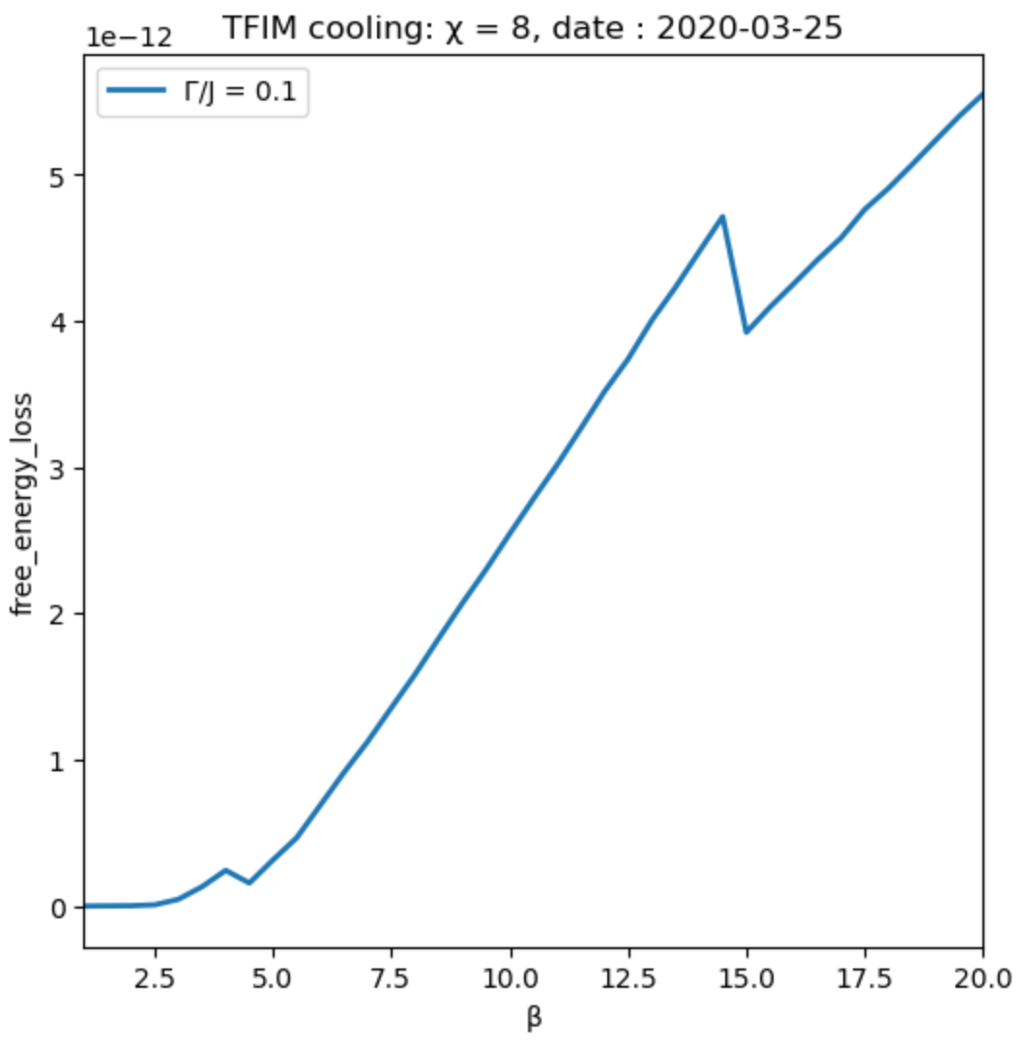
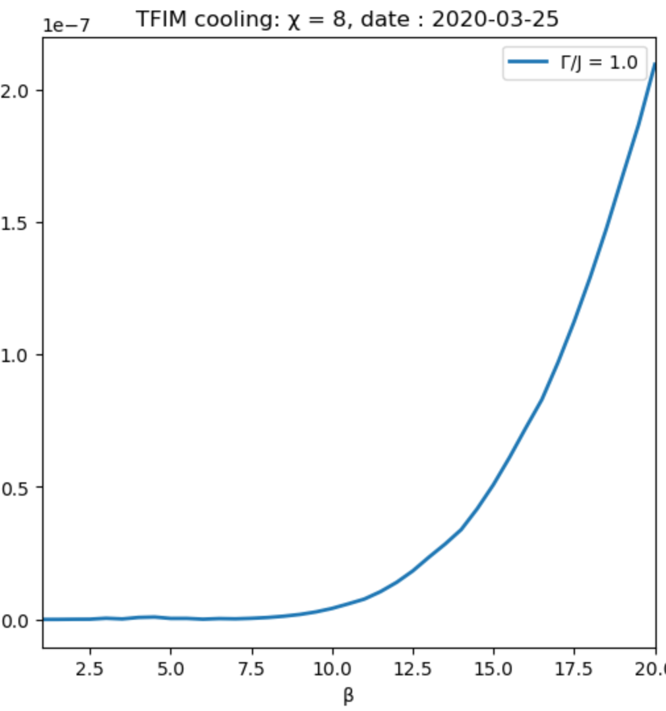
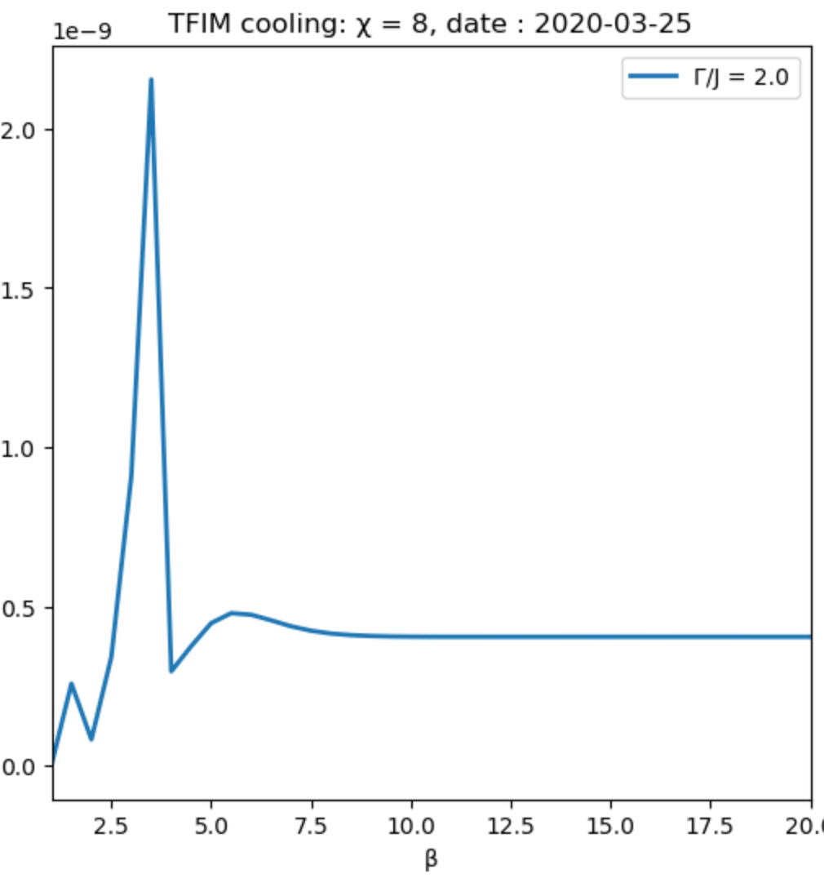
2020.03.25 : Cool, free energy loss
Notes:
fixed init ++-| from now on

Slide 5
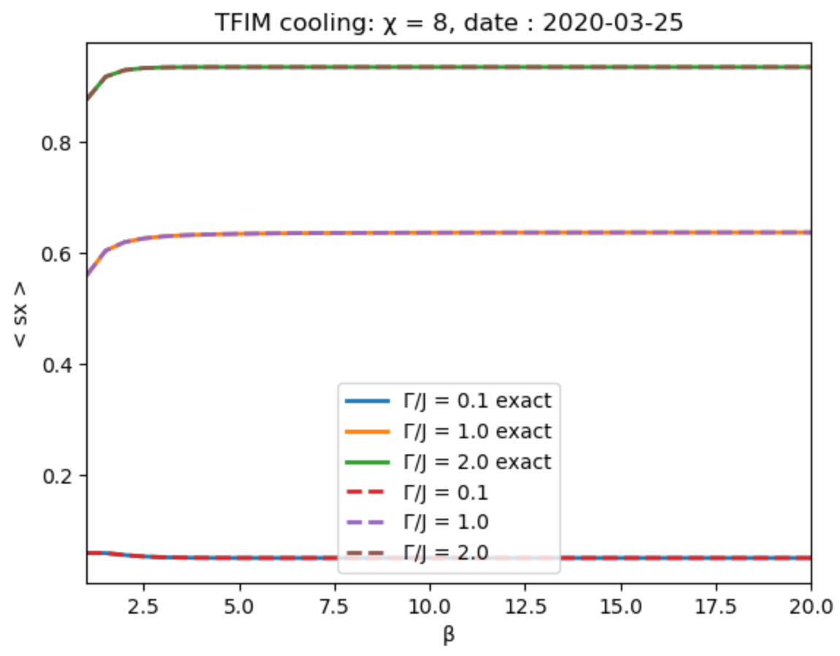
Cool, < sx >
Notes:
init ++-|

Slide 6
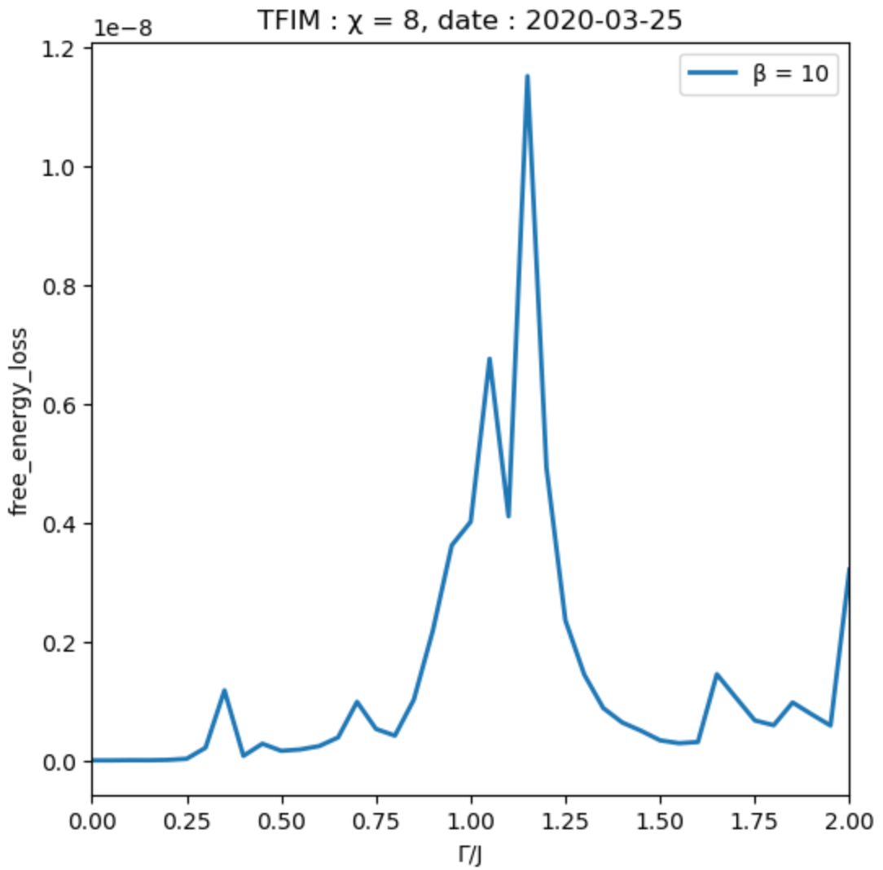
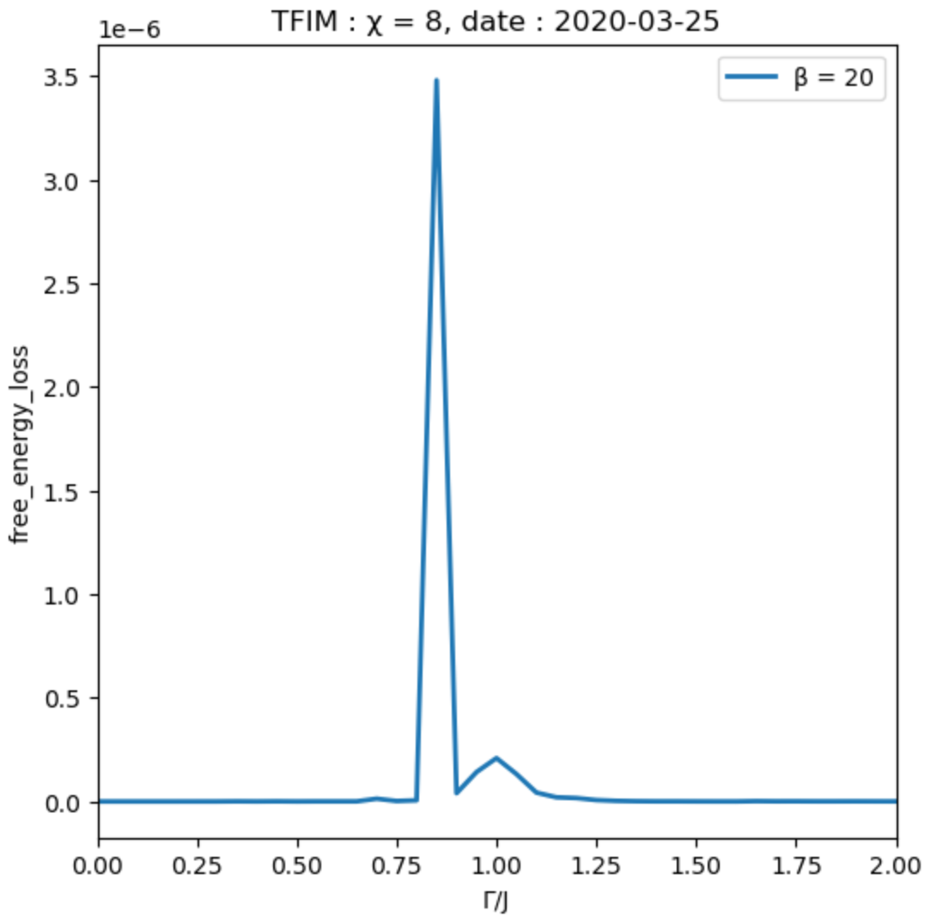
++-|: β=10, 20 free energy loss
Notes:
for every gamma， init cmps = ++-|

Slide 7
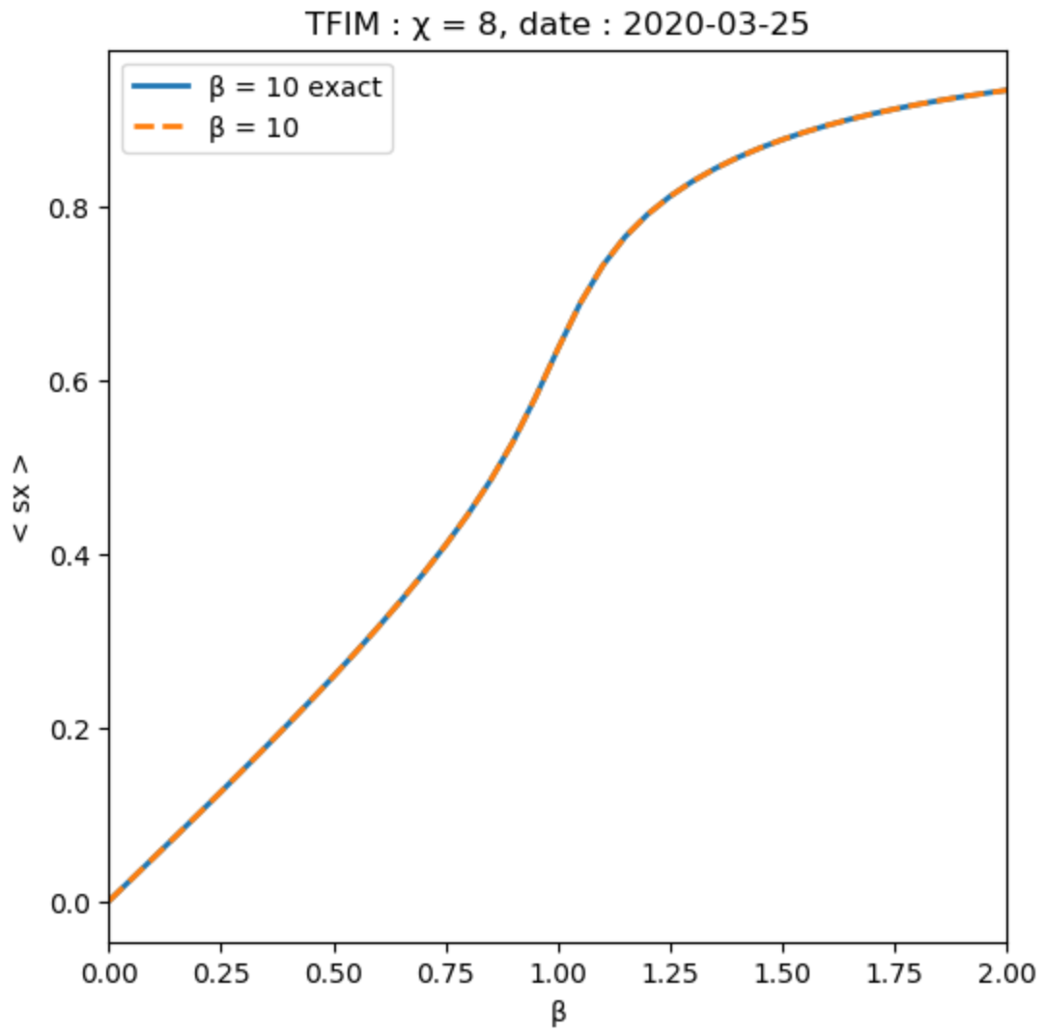

++-|: β=10, 20 < sx >
Notes:
for every gamma， init cmps = ++-|

Slide 8
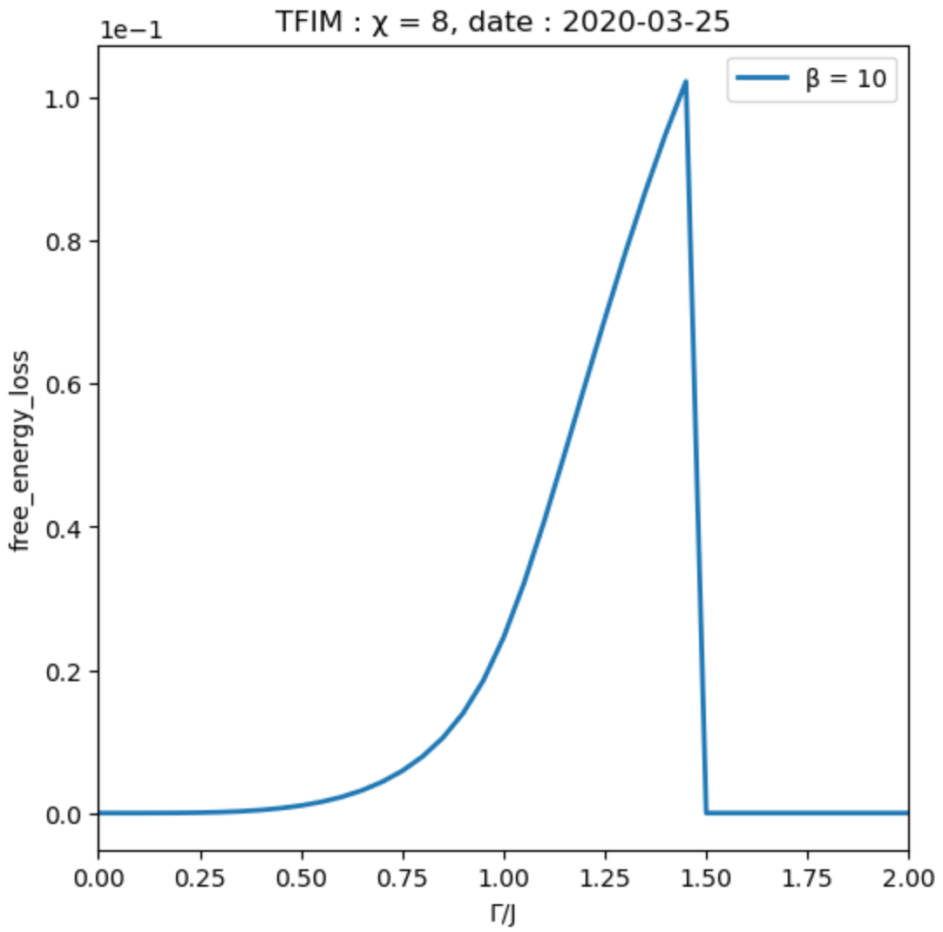
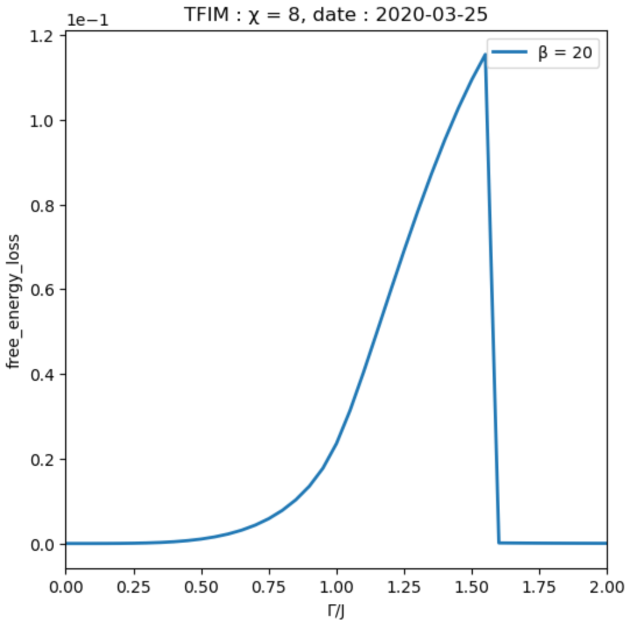
++-|, g[1]: β=10, 20 free energy loss
Notes:
init ++-|， gamma = 0, 后一步用前一步结果

Slide 9
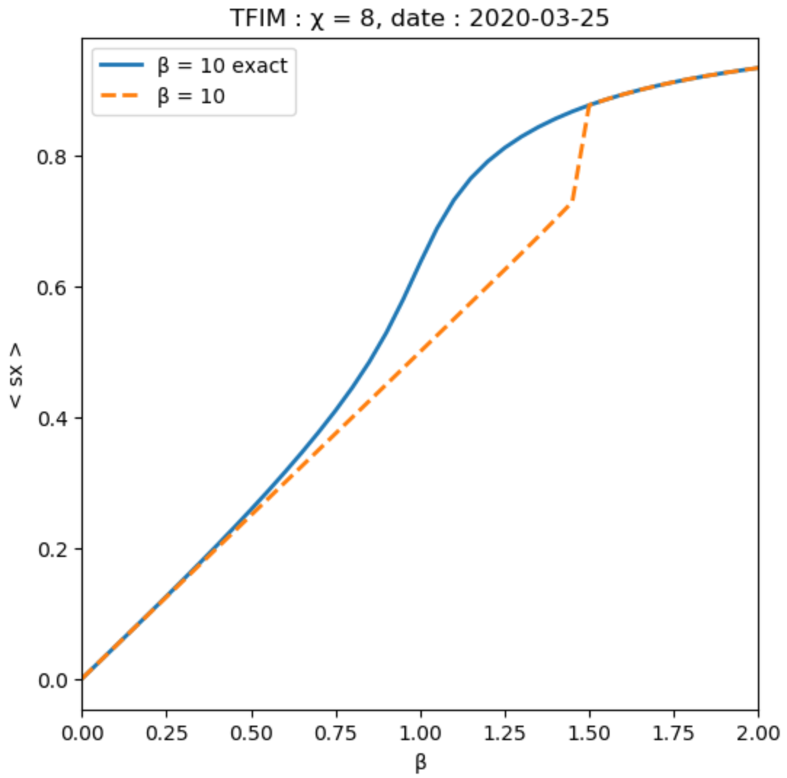
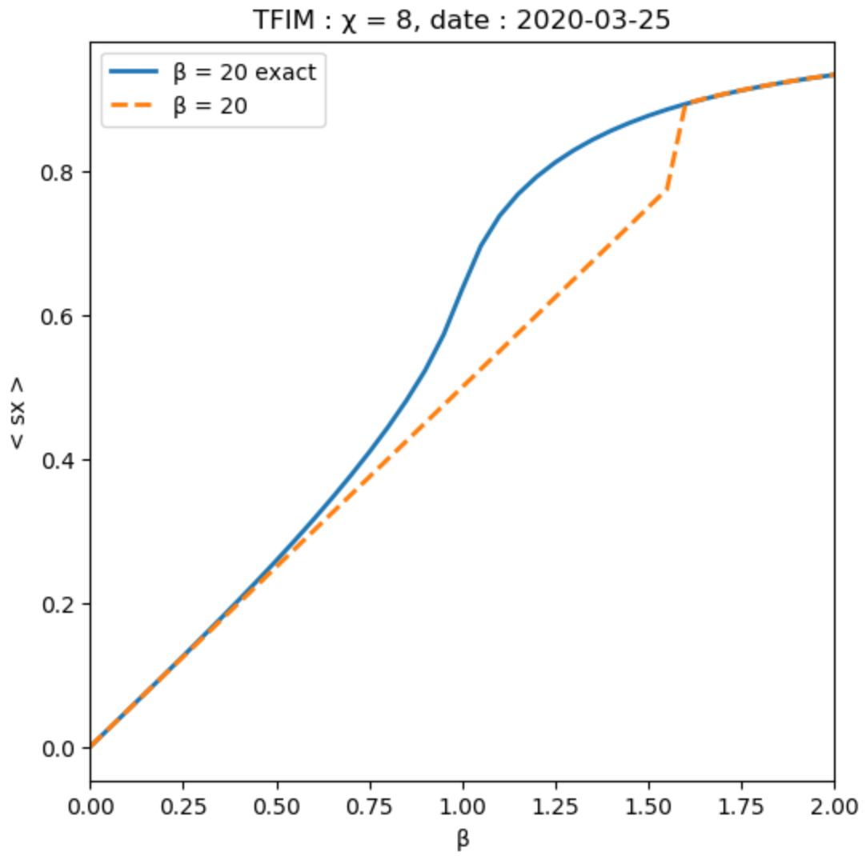
++-|, g[1]: β=10, 20 < sx >
Notes:
init ++-|， gamma = 0, 后一步用前一步结果

Slide 10
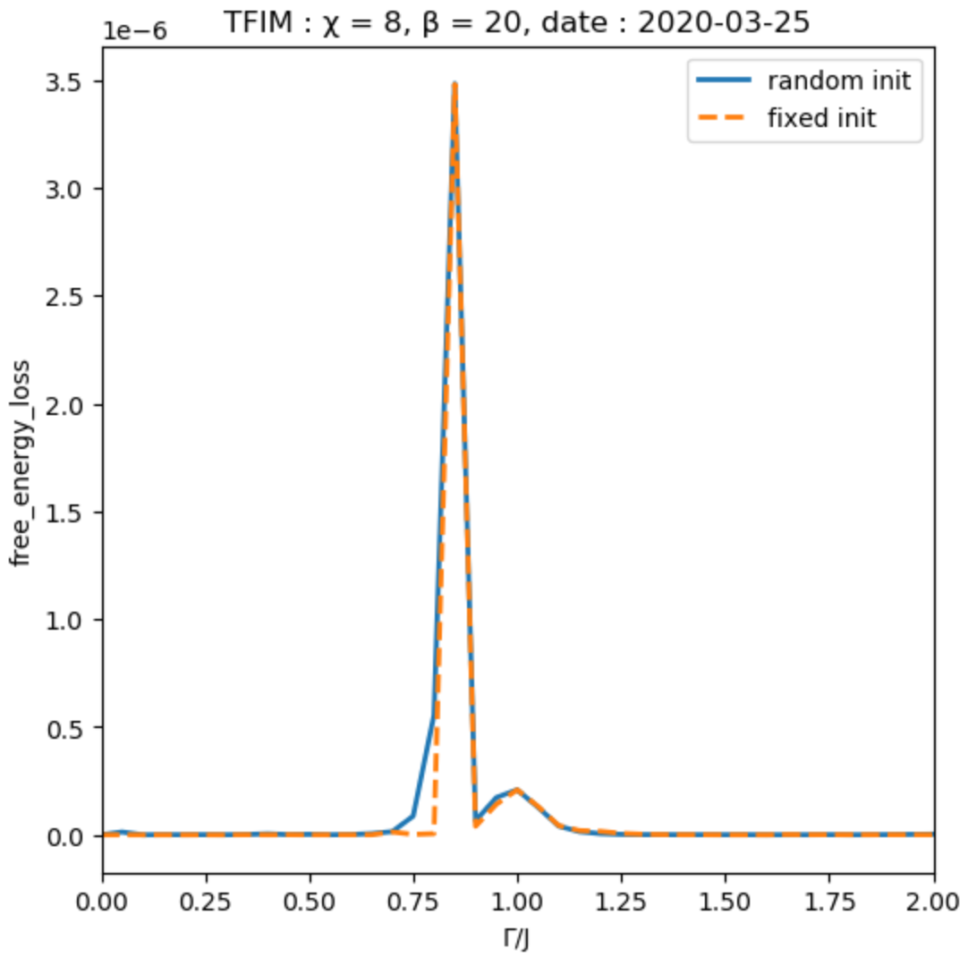
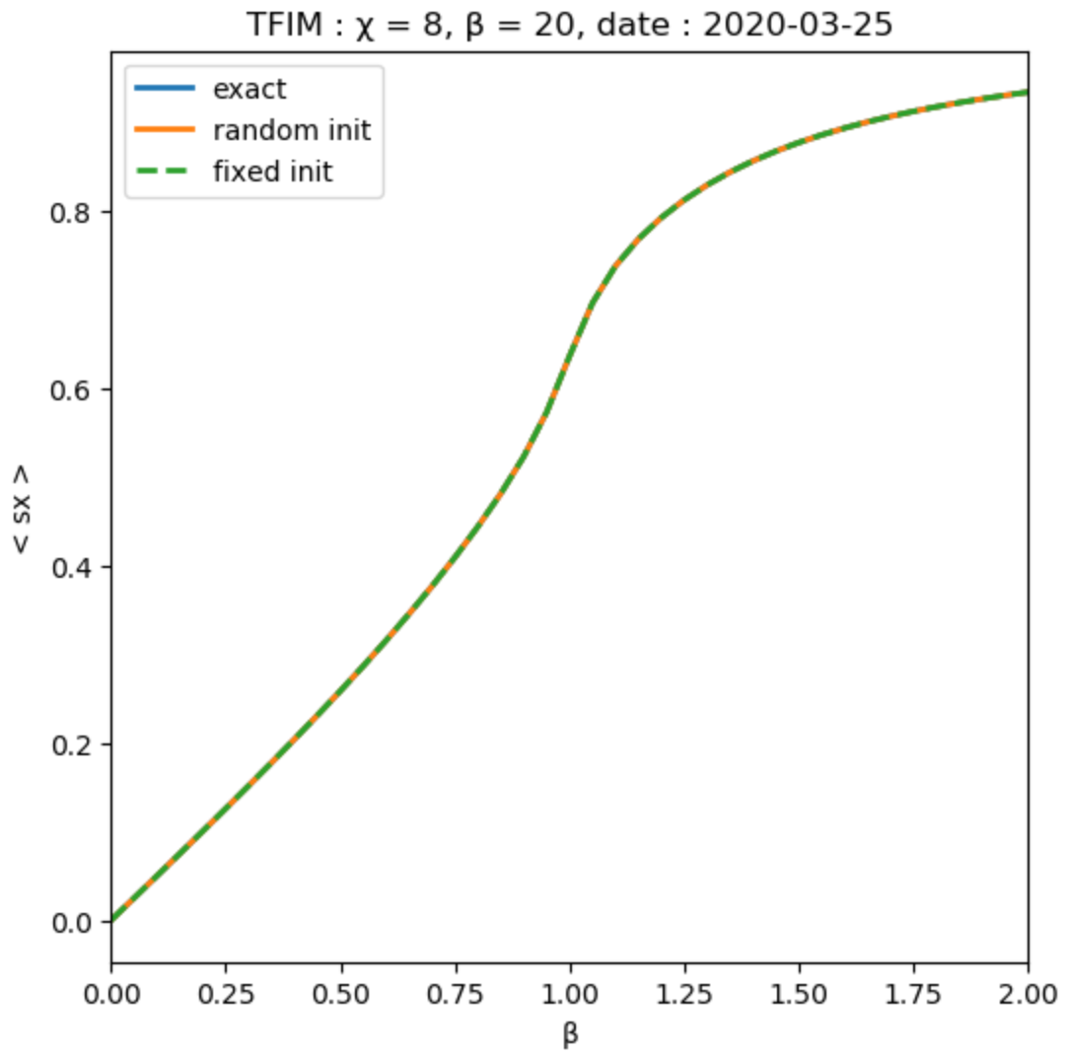
init compare: β=20
CMPO works fine even for random init !
Notes:
init ++-|， gamma = 0, 后一步用前一步结果

Slide 11
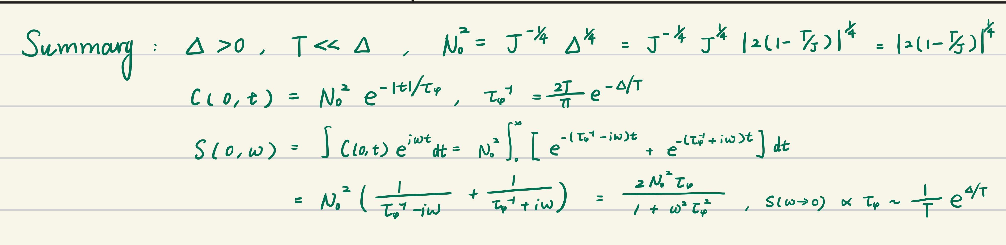
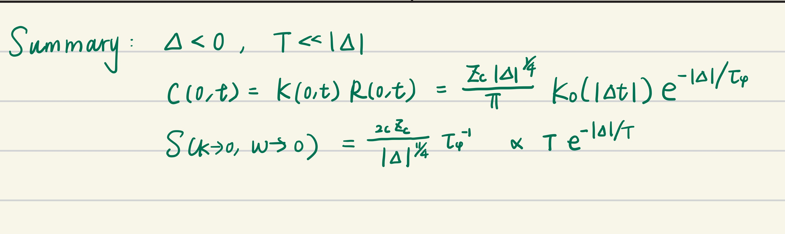
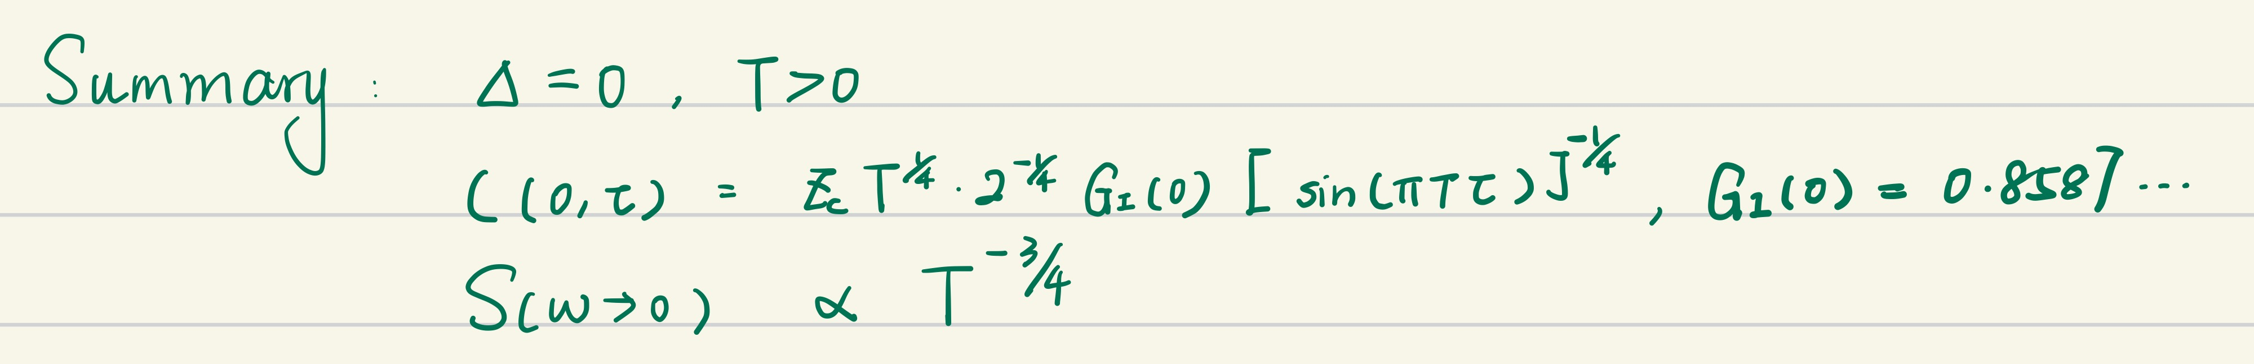
TFIM: theoretical results

Slide 12
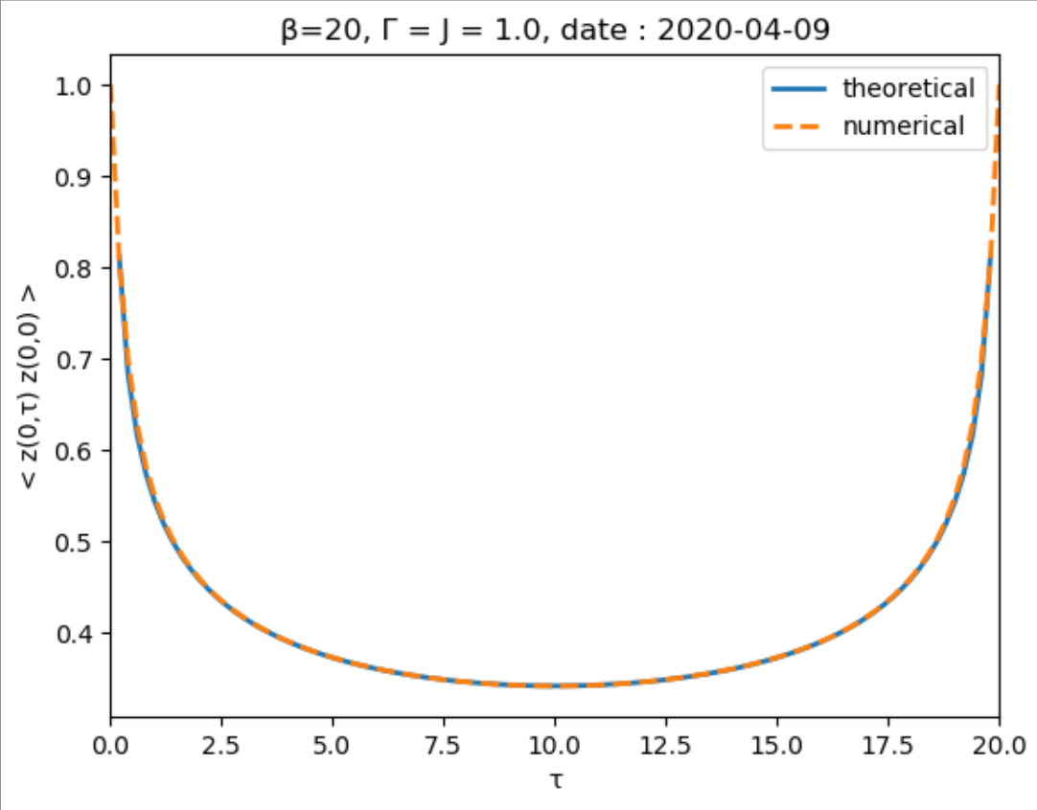
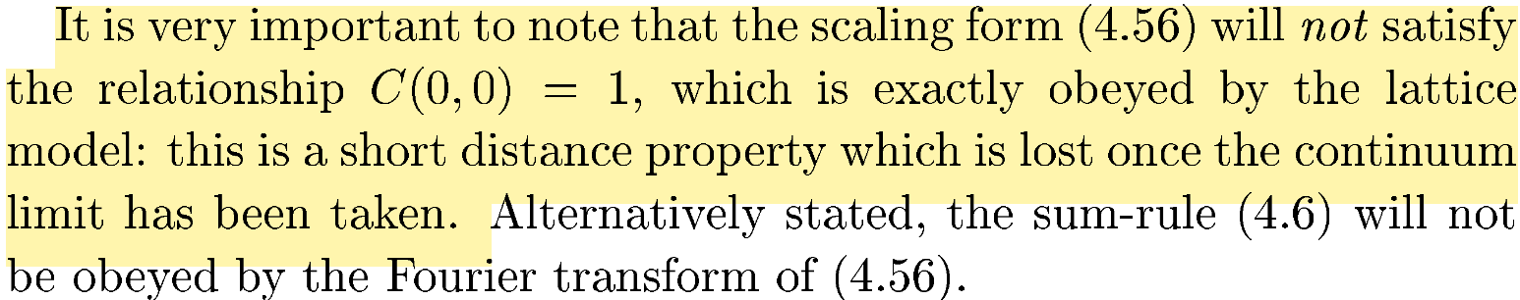
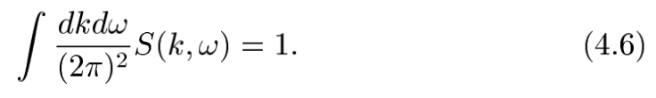
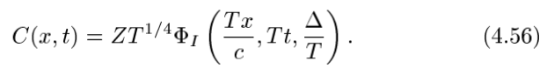
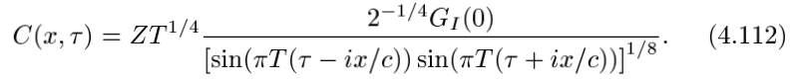
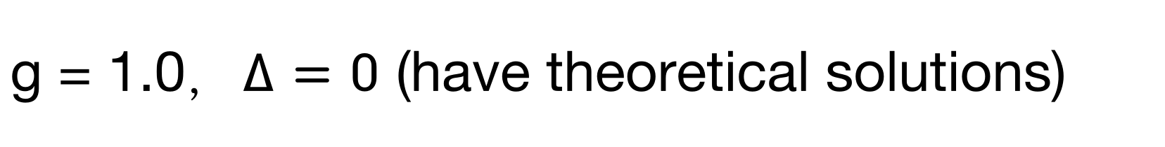
g = 1.0，$∆=0$ (have theoretical solutions)

Slide 13
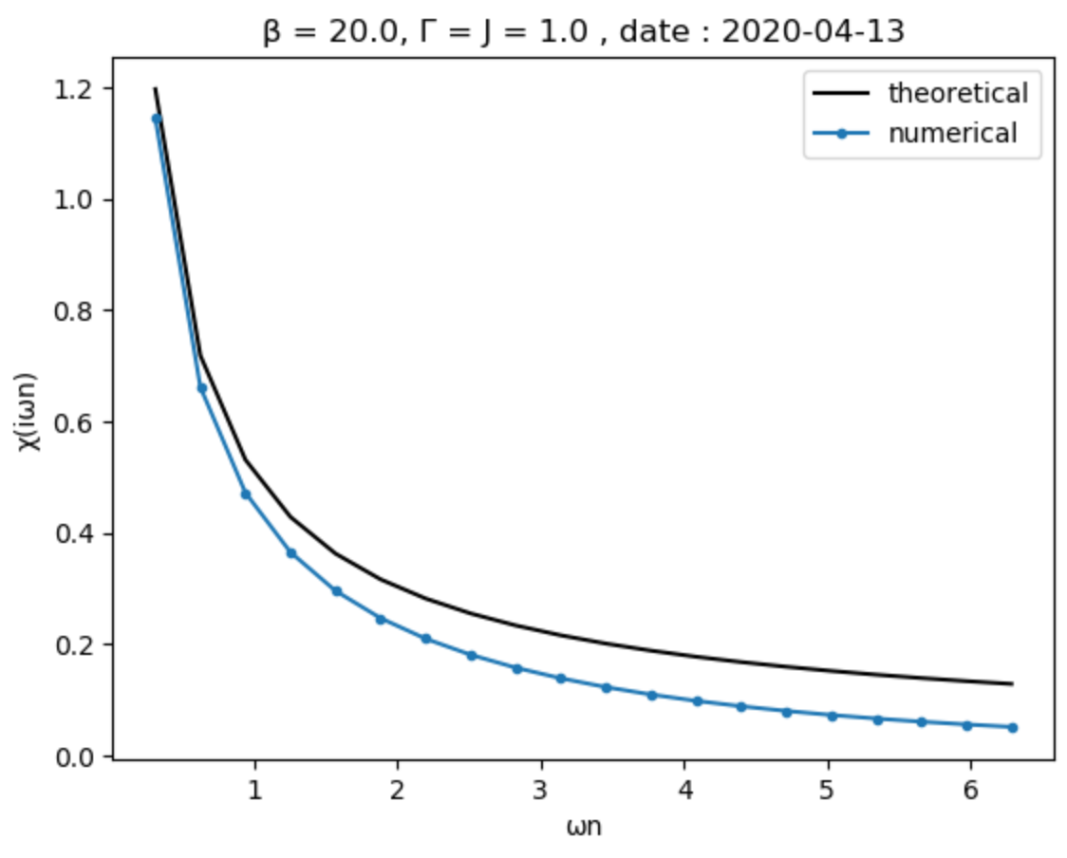
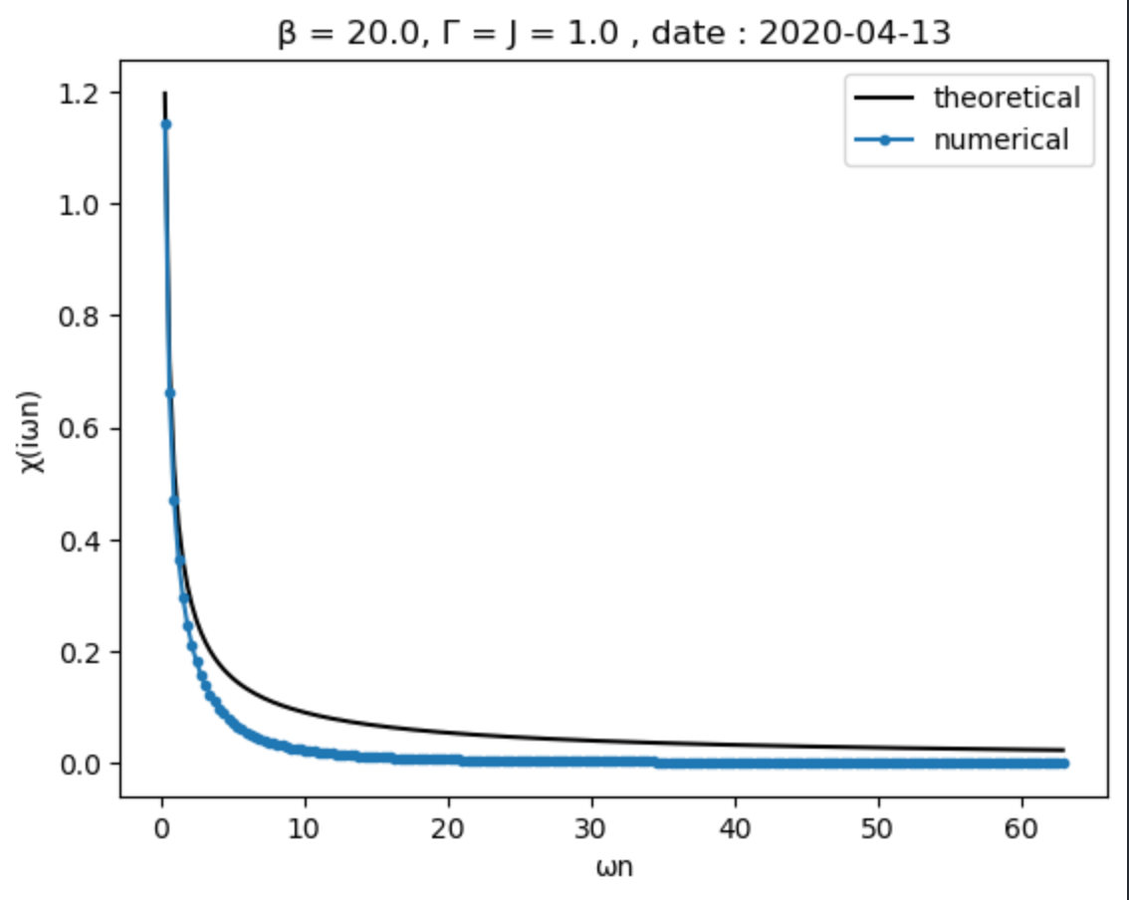
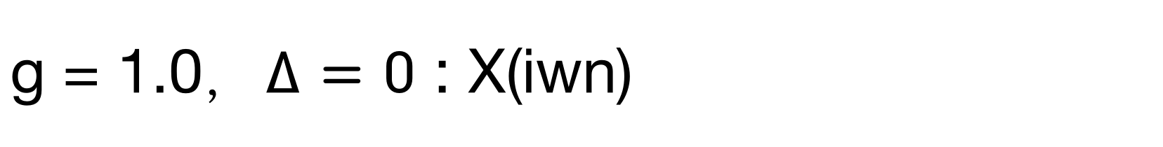
g = 1.0，$∆=0$ : X(iwn)

Slide 14
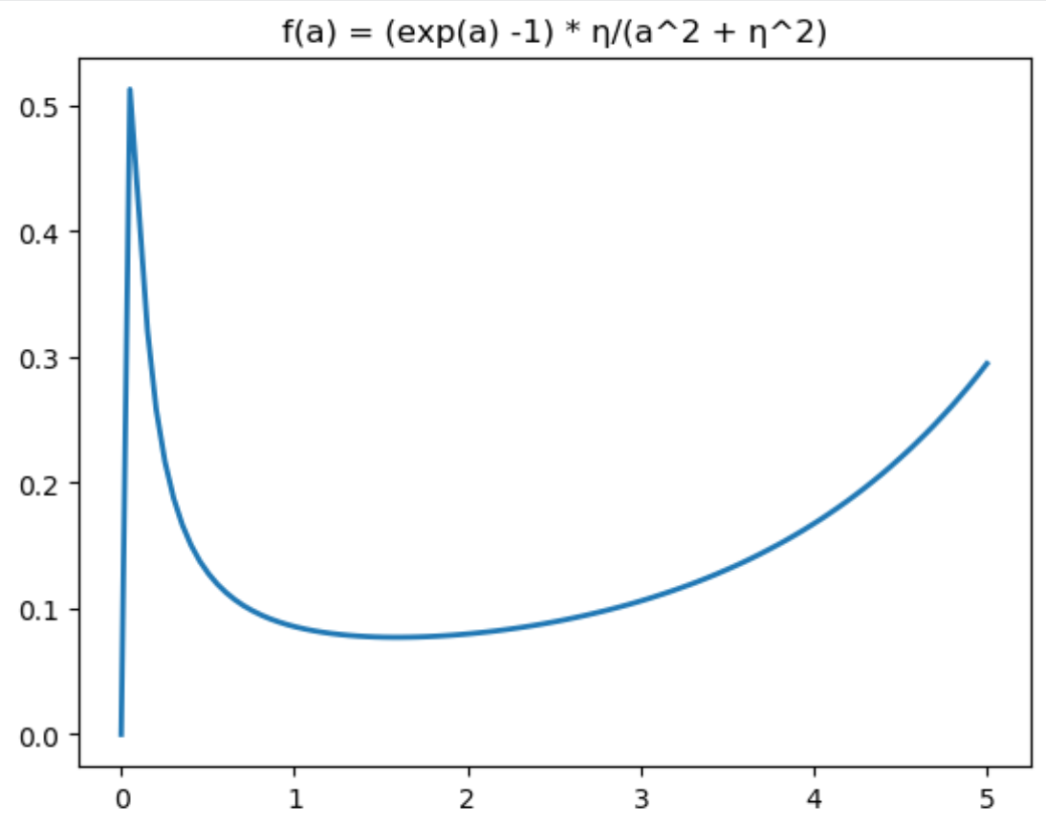
Notes:
maxima ~ \eta

Slide 15
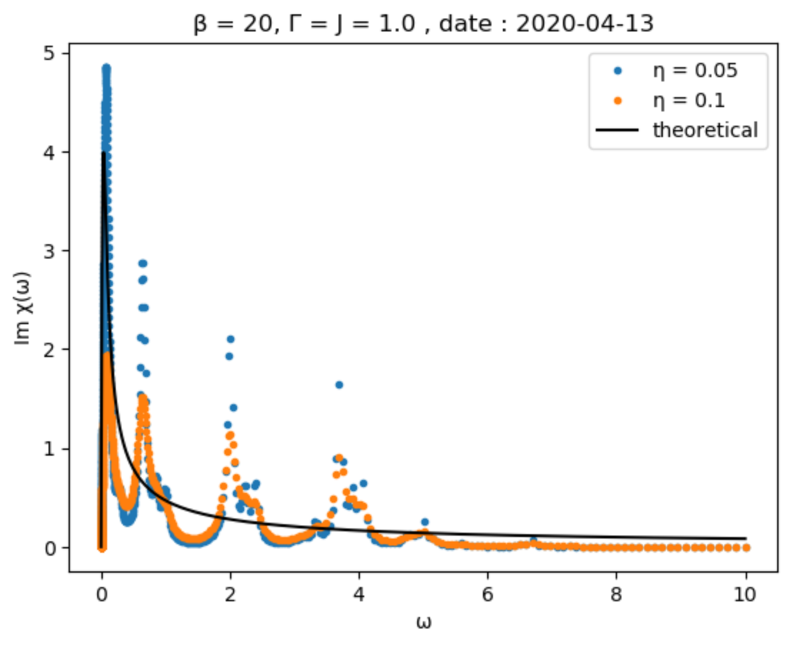
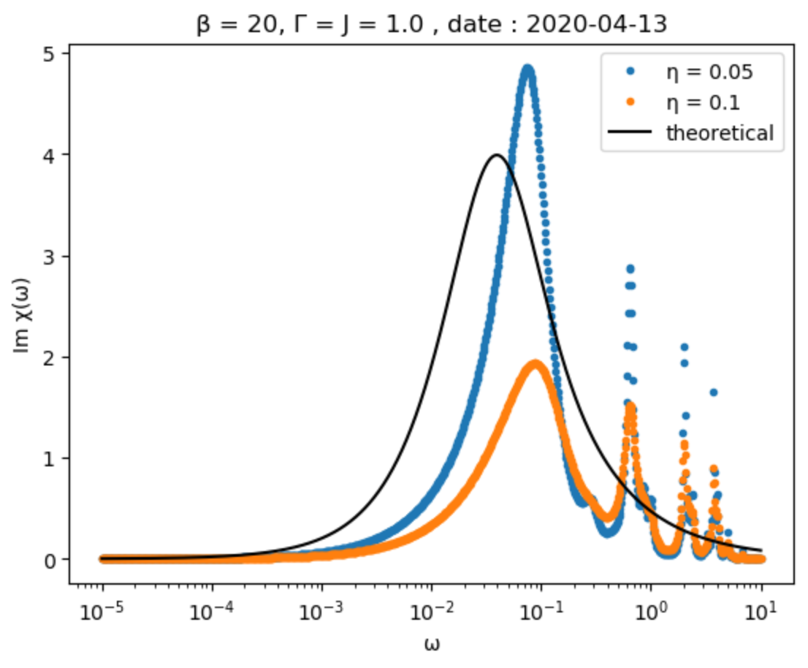
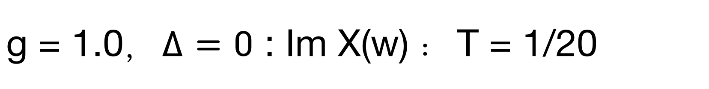
g = 1.0，$∆=0$ : Im X(w) ：T = 1/20

Slide 16
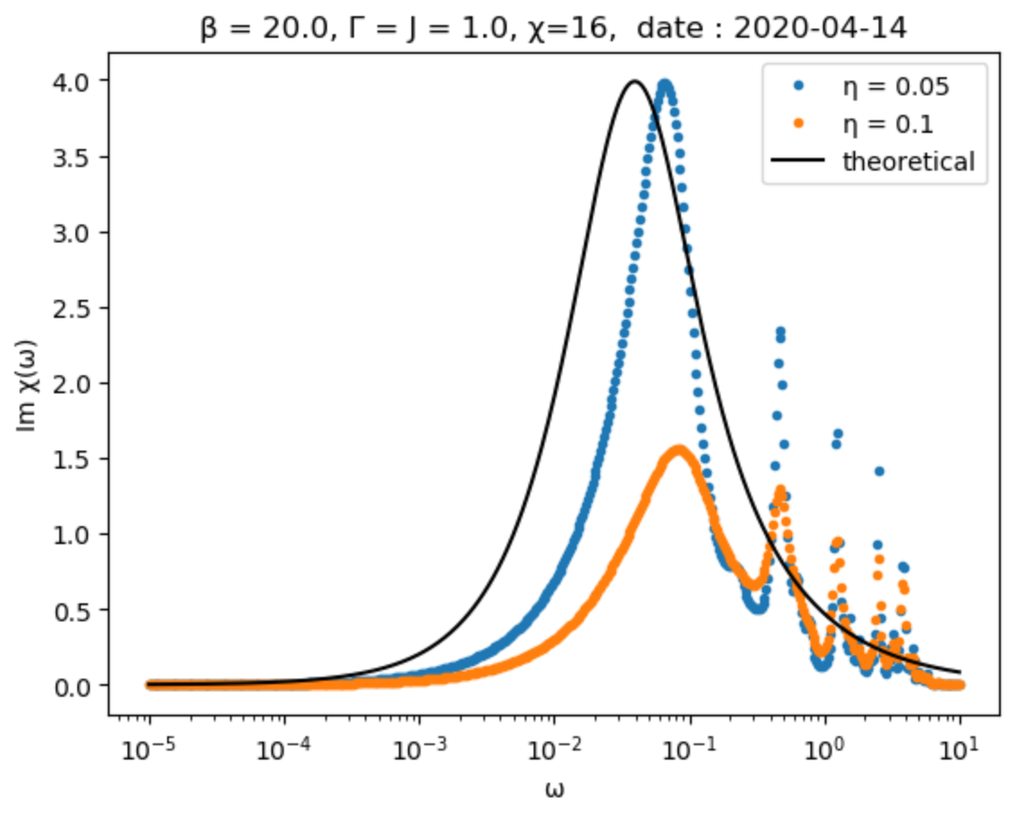
g = 1.0，$∆=0$ : Im X(w) ：T = 1/20

Slide 17
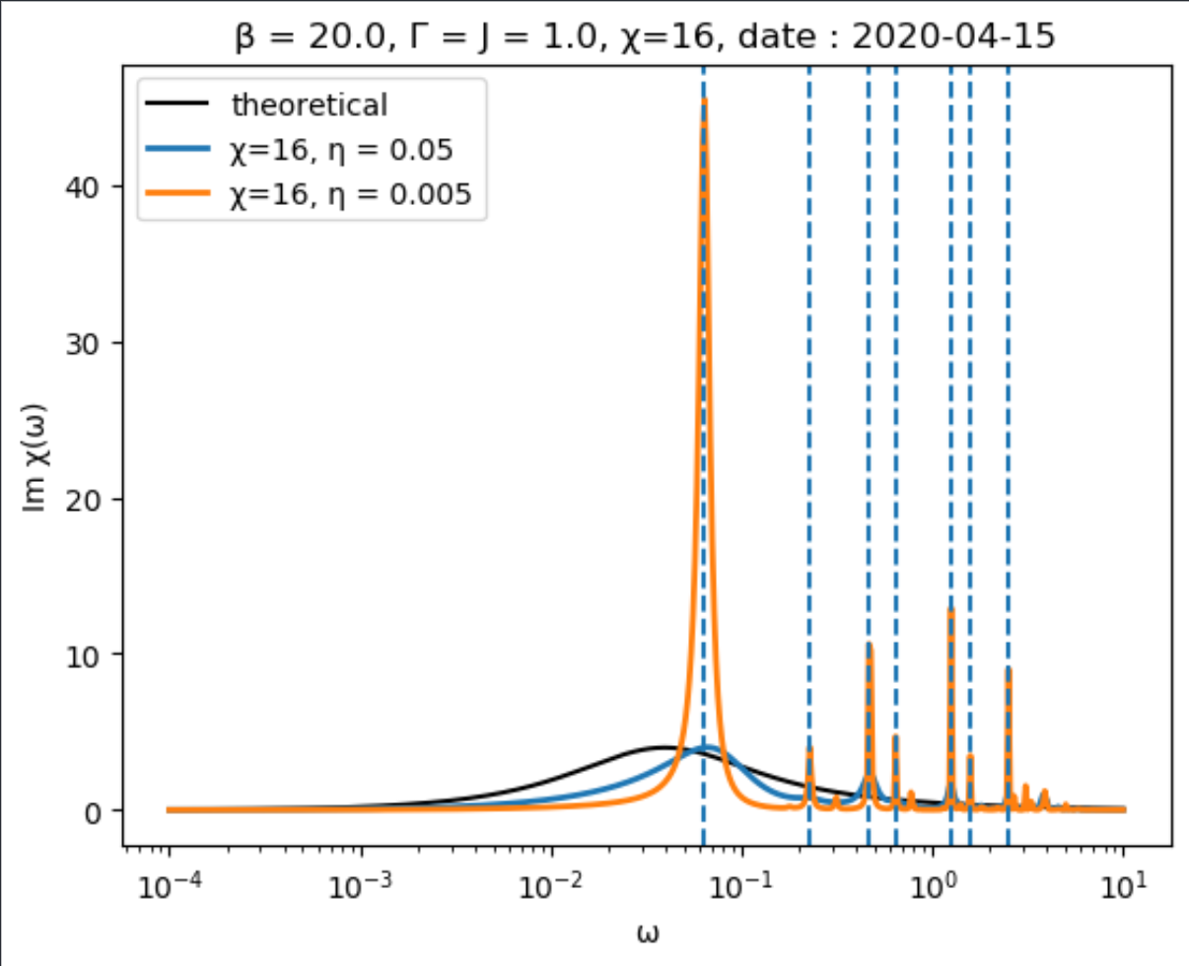
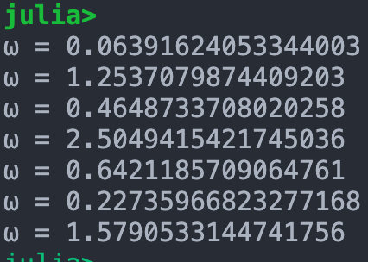
g = 1.0，$∆=0$ : Im X(w) ：T = 1/20

Slide 18
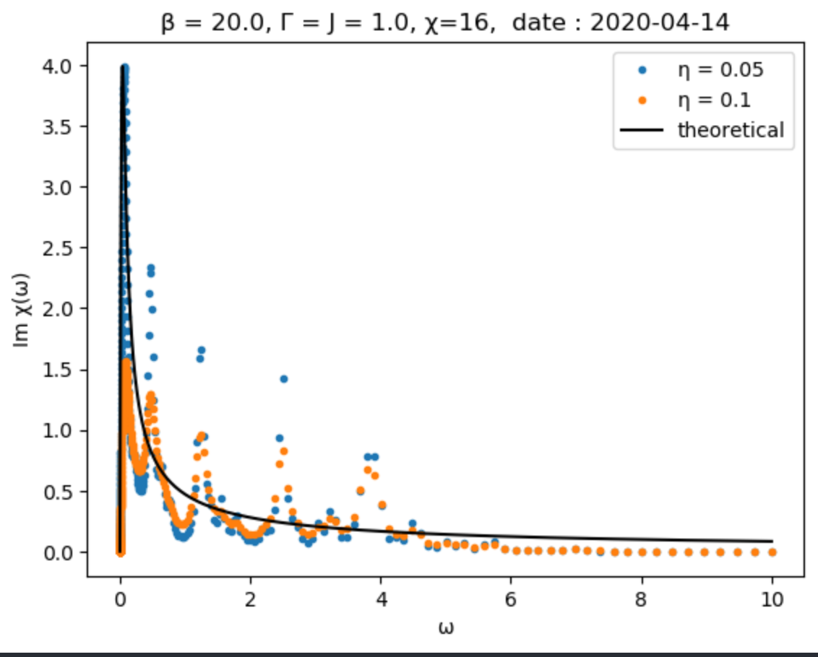
g = 1.0，$∆=0$ : Im X(w) ：T = 1/20

Slide 19
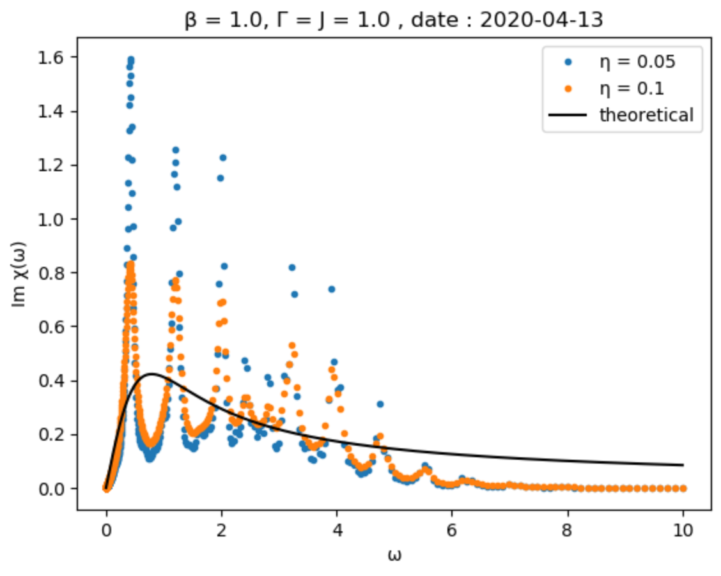
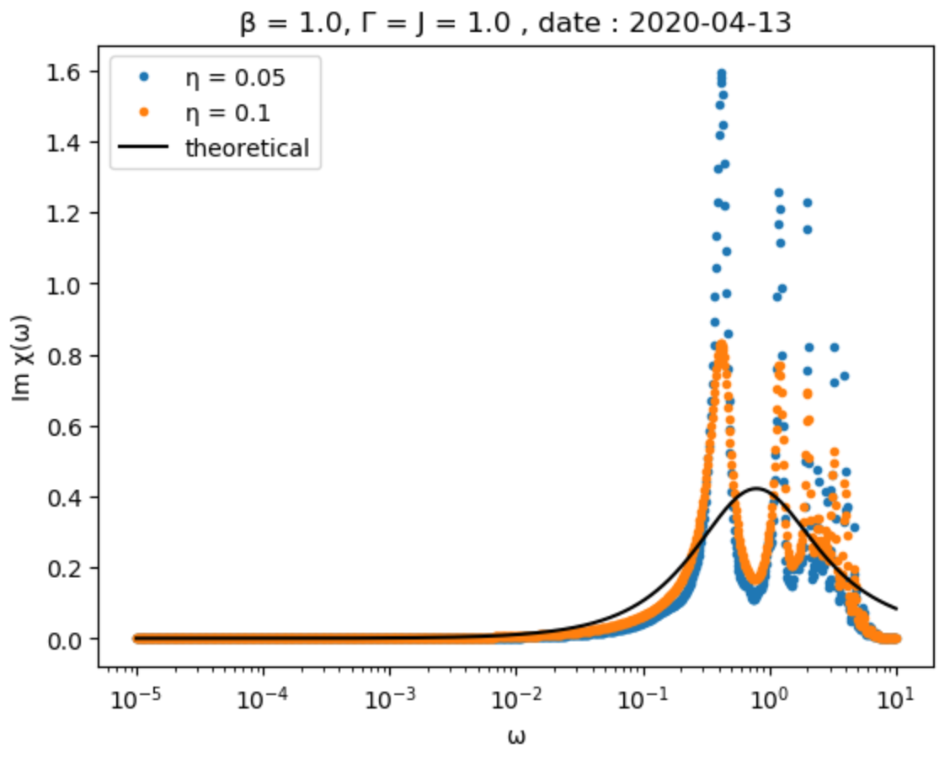
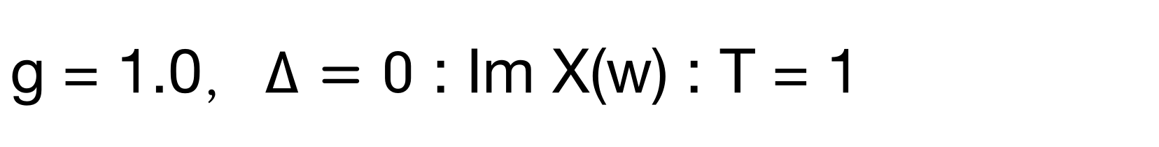
g = 1.0，$∆=0$ : Im X(w) : T = 1

Slide 20
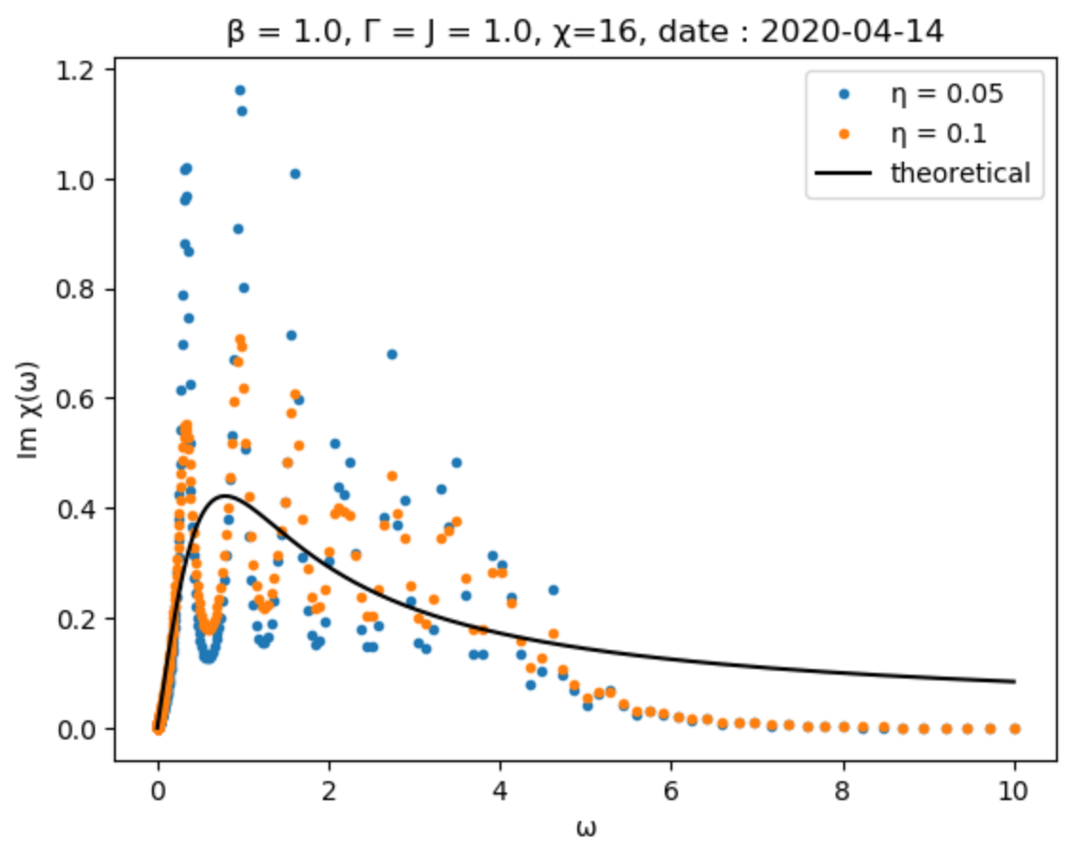
g = 1.0，$∆=0$ : Im X(w) : T = 1

Slide 21
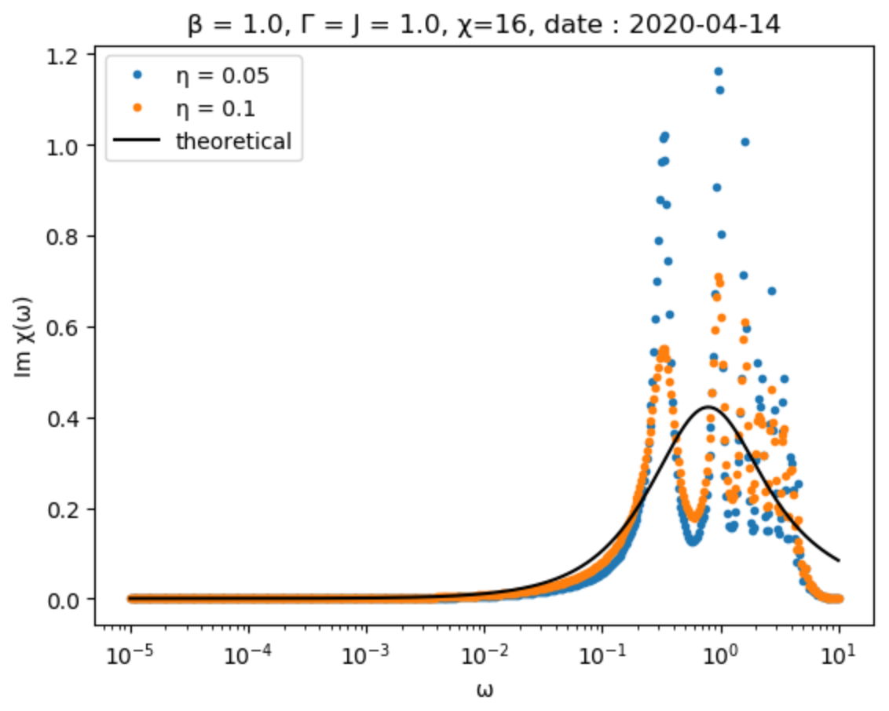
g = 1.0，$∆=0$ : Im X(w) : T = 1

Slide 22
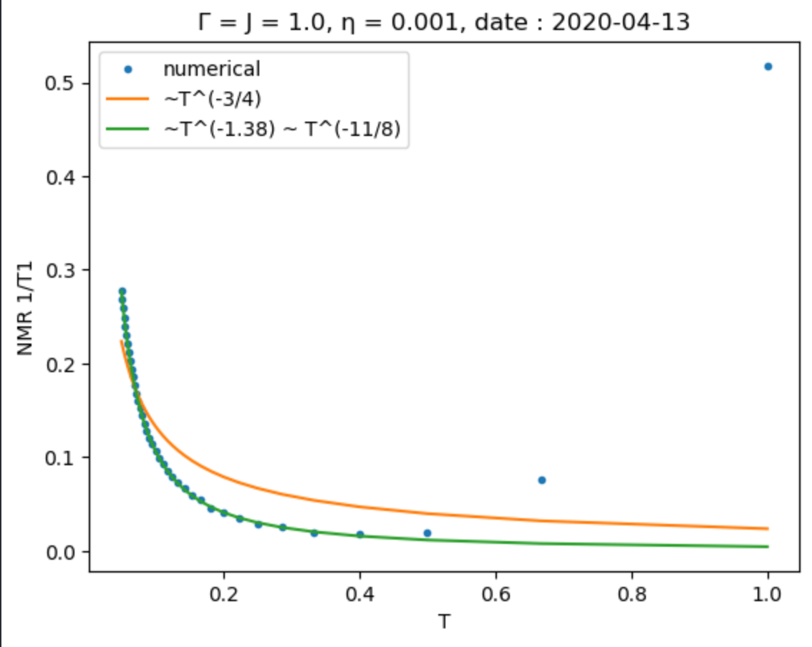
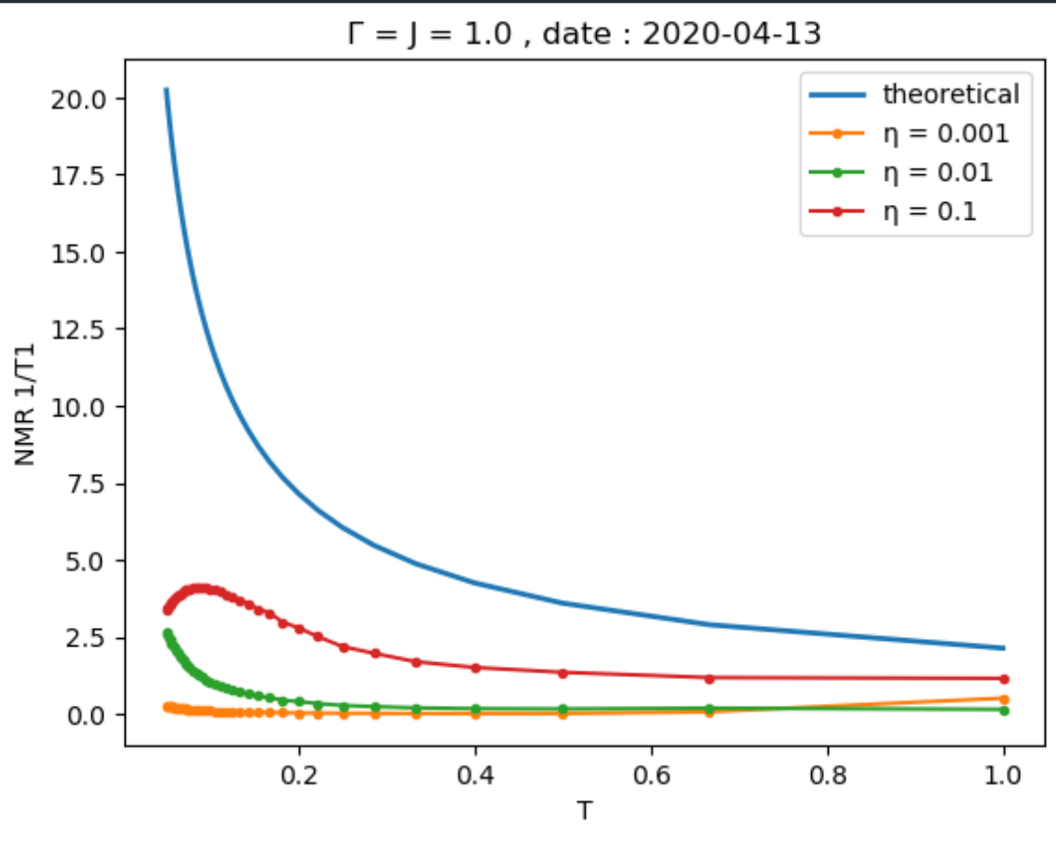
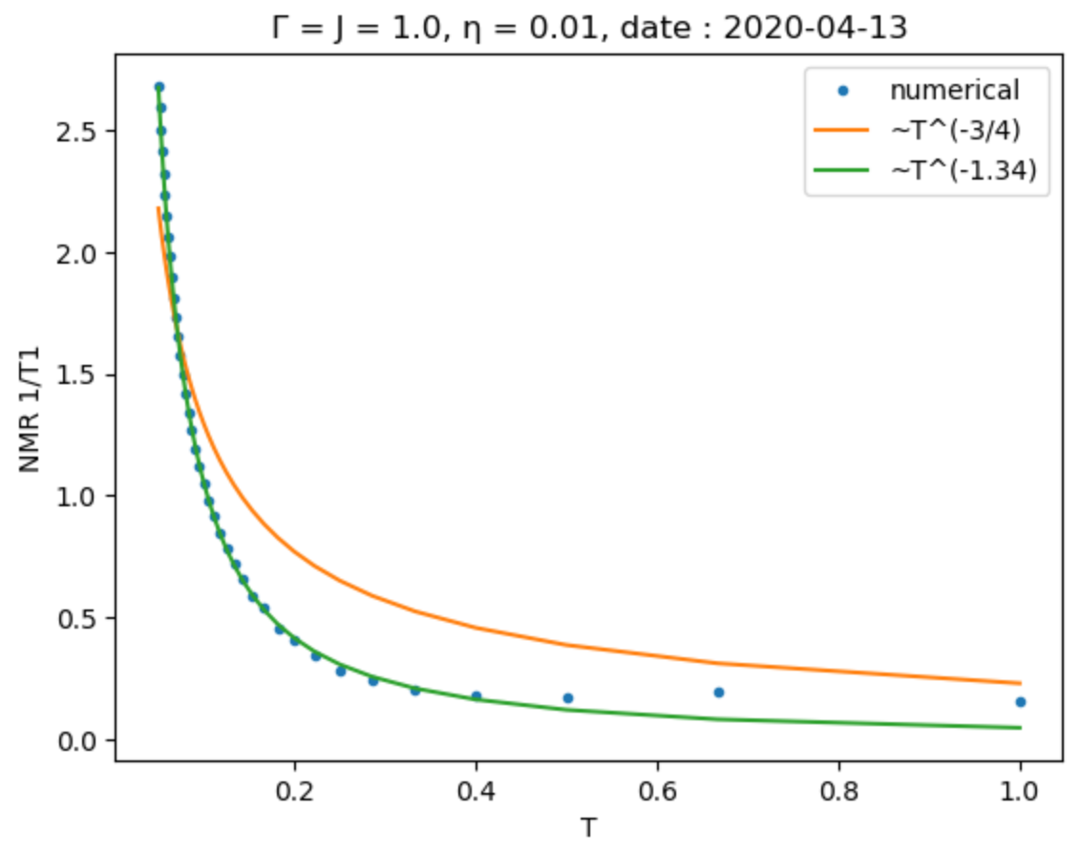
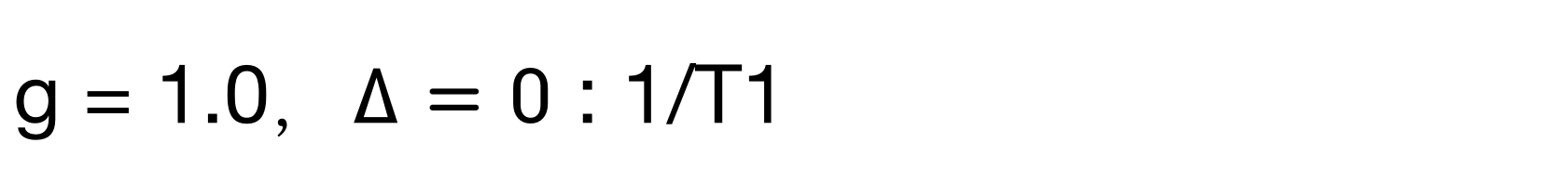
g = 1.0，$∆=0$ : 1/T1
Notes:
theoretical 2.13 T^(-3/4)

Slide 23
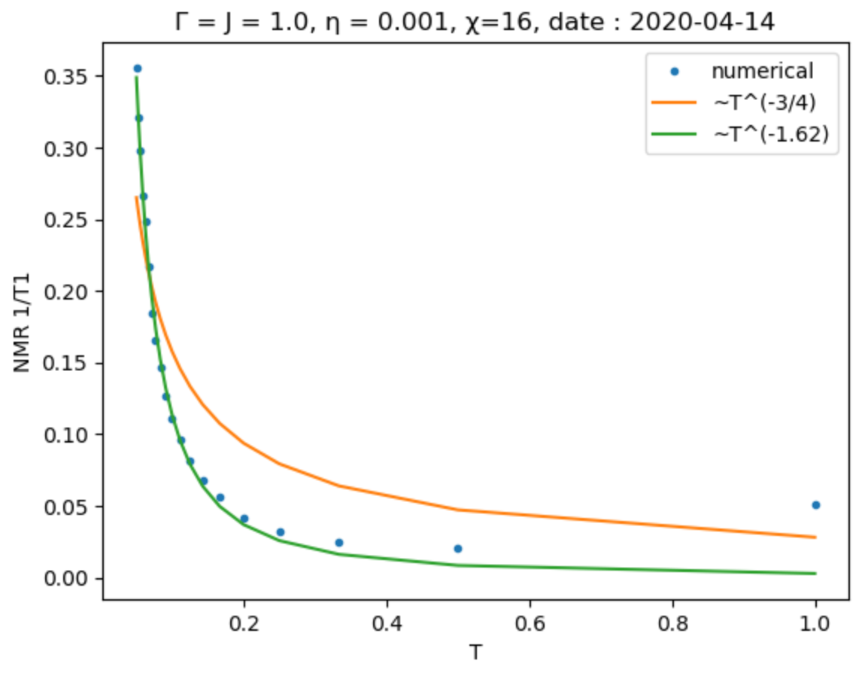
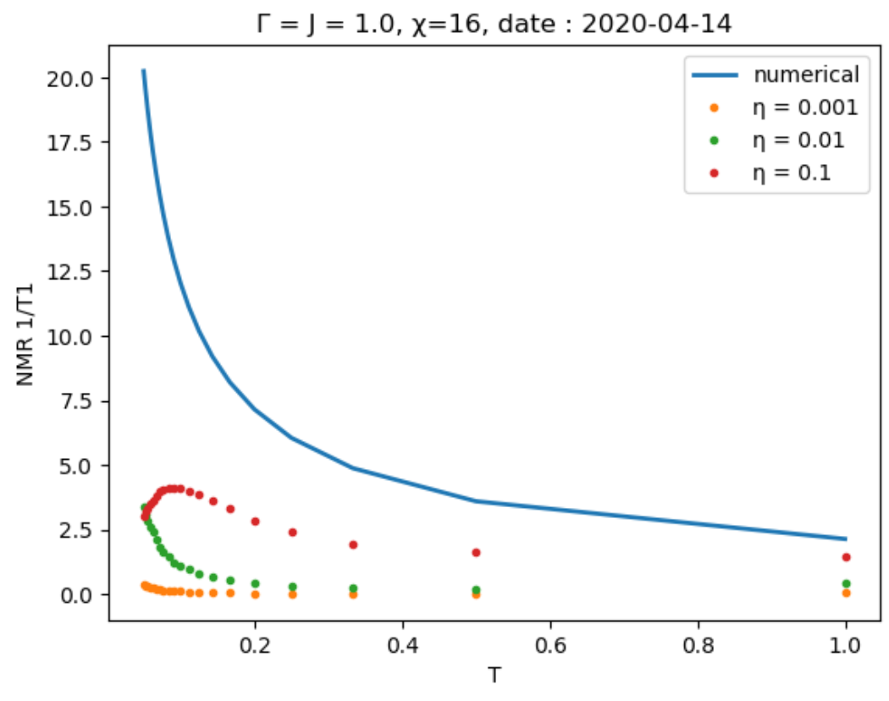
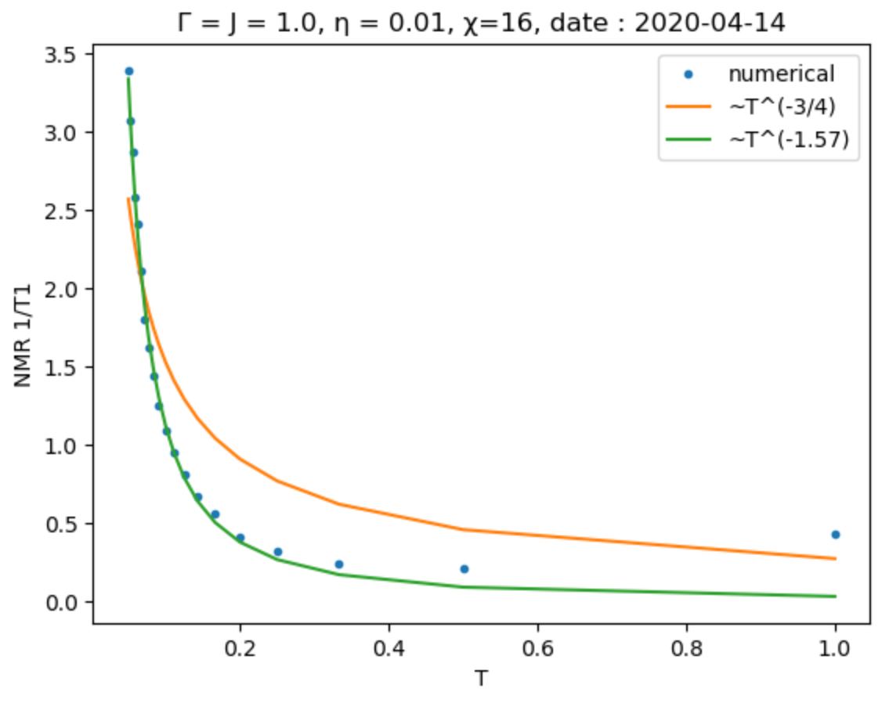
g = 1.0，$∆=0$ : 1/T1
Notes:
theoretical 2.13 T^(-3/4)

Slide 24
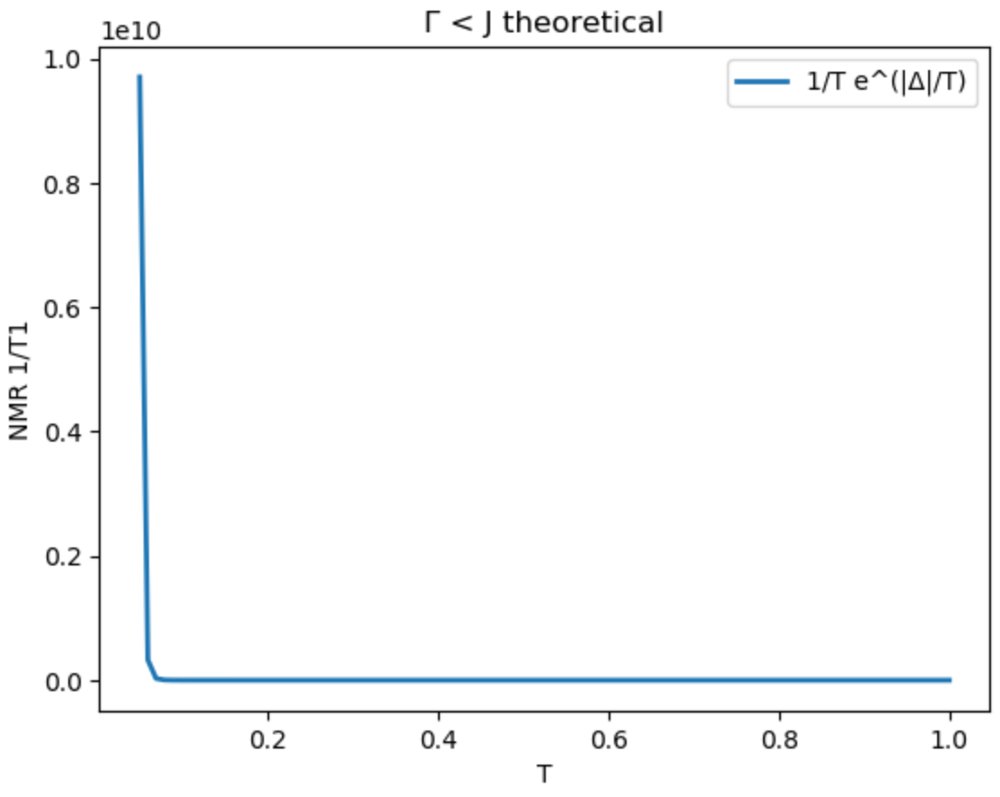
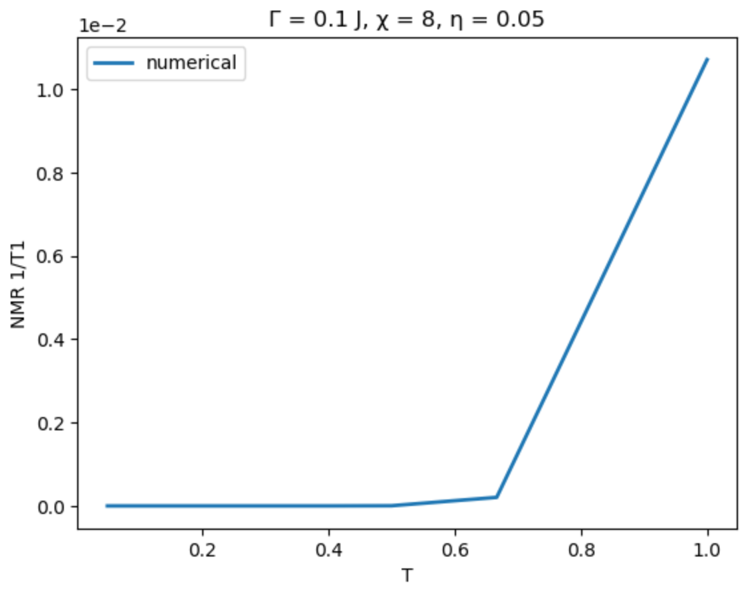

g = 0.1, $∆ = 1.8$

Slide 25



g = 2.0, $∆=−2$

Slide 26


2020-04-20

Slide 27


2020-04-20

Slide 28

g = 0.1, $∆ = 1.8$

Slide 29


g = 2.0, $∆=−2$

Slide 30


g = 2.0, $∆=−2$

